Slide 1

CRO | AMU | LP | Next Gen 360 Campaign | /military-degrees/overview (10893)
American Military University
CRO | 2026
American Public Education Inc. Do Not Distribute.

Slide 2
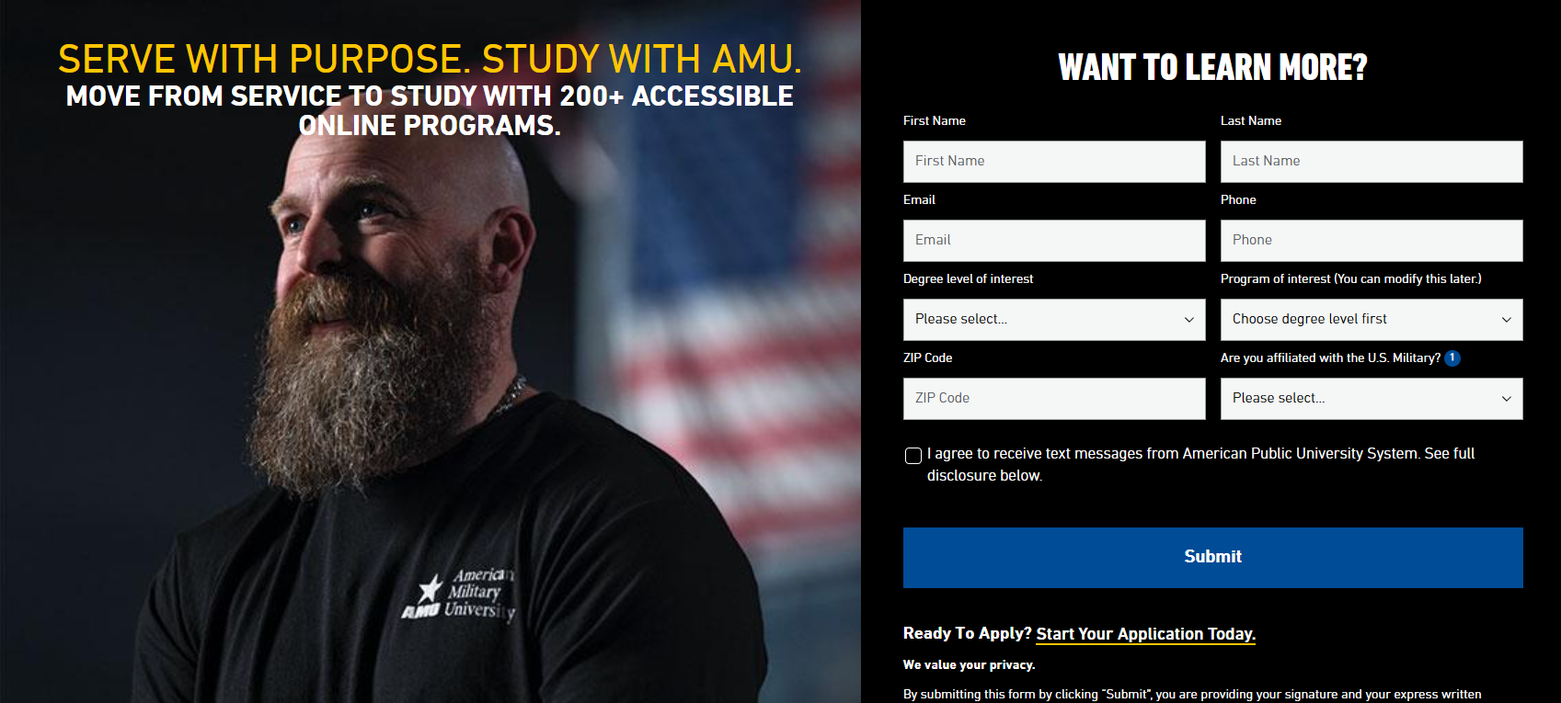
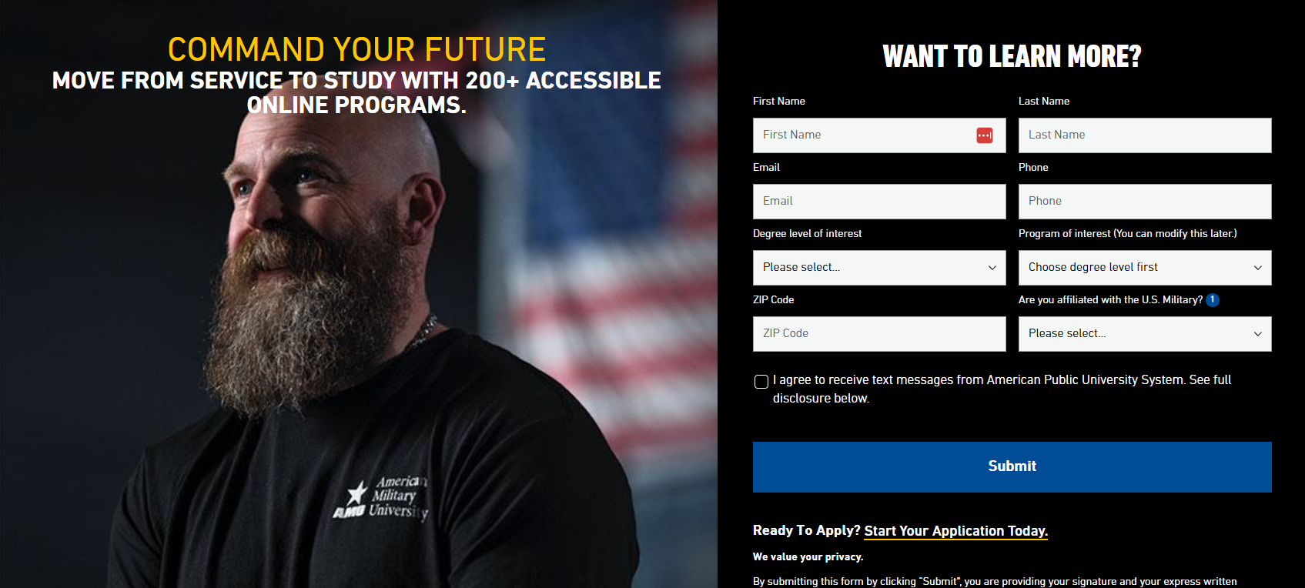
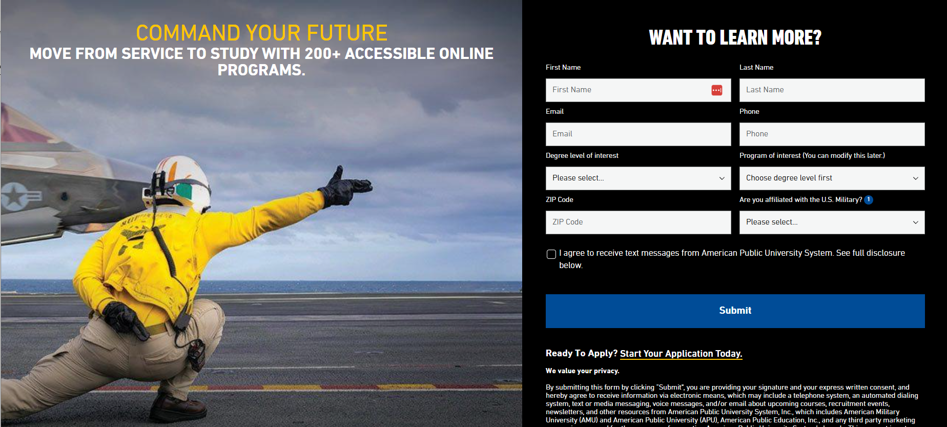
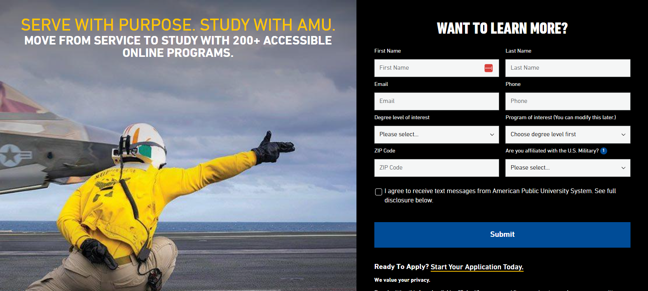


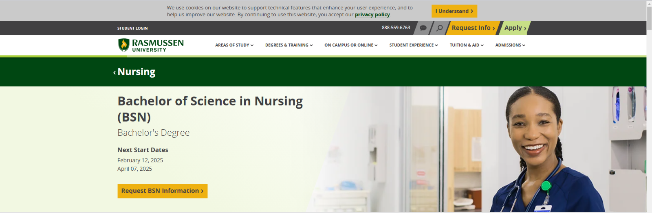
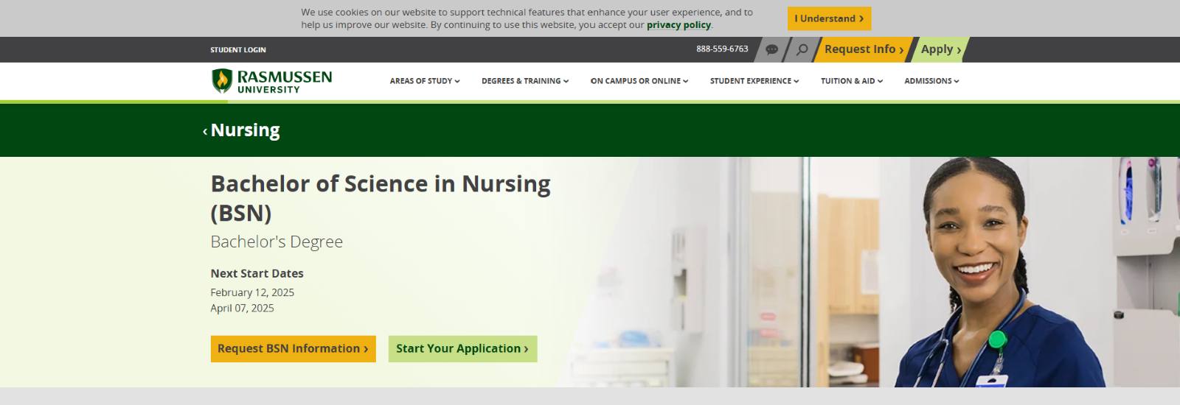
RESULTS
CRO | AMU | LP | Next Gen 360 Campaign | /military-degrees/overview (10893)
INCONCLUSIVE
Hypothesis
If we use the Next Gen 360 hero image and copy,
then brand RFI will match or beat the control,
because the creative keeps the same military value proposition.
CONTROL
RFI: 91 Apps: 52
PRIMARY METRIC: RFI
Brand RFI Lift (New Hero): | +2.05%
All Traffic RFI Lift (New Copy): | +4.58%
Statistical Significance: | Below 90% on RFI (max 69%)
Annualized Incremental Revenue: | $0 (shipped, not credited)
NEW COPY
RFI: 83 (-6.72% | 68% worse)
Apps: 65 (+27.84% | 91%)
Rev: $652,663
NEW HERO (SHIPPING)
RFI: 100 (+2.05% | 56%)
Apps: 63 (+12.51% | 74%)
Rev: $372,260
No variation cleared 90% on RFI in the targeted brand campaigns, the scope of this test. App Complete gains rest on 10 to 13 events. Paid media reports on RFI, so this image and copy combination should not roll to paid LPs. Keep control; retest new copy later.
Duration: 15 Days
Result:
NEW IMAGE
RFI: 84 (-7.25% | 70% worse)
Apps: 62 (+19.80% | 84%)
Rev: $425,231
Test Period: 09/14/2026 to 09/29/2026 (data through 09/28)
Page: start.amu.apus.edu/military-degrees/overview | Panel and table: targeted brand campaigns

Slide 3
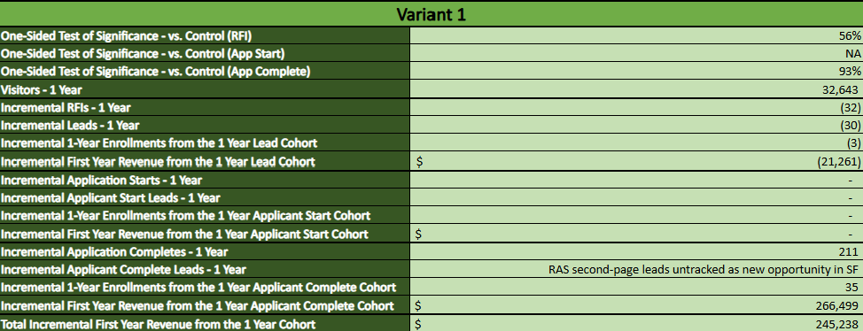
REVENUE CALCULATOR
 | Control | New Copy | New Hero | New Image
RFI Conversions, Brand Specific Campaigns | 91 | 83 | 100 | 84
RFI Lift %, Brand Specific Campaigns | Baseline | -6.72% | +2.05% | -7.25%
Statistical Significance, RFI, Brand Specific Campaigns | Baseline | 68% worse | 56% | 70% worse
App Completes, Brand Specific Campaigns | 52 | 65 | 63 | 62
App Lift %, Brand Specific Campaigns | Baseline | +27.84% | +12.51% | +19.80%
Statistical Significance, App, Brand Specific Campaigns | Baseline | 91% | 74% | 84%
RFI Lift %, All Campaigns | Baseline | +4.58% | -0.56% | +1.14%
Statistical Significance, RFI, All Campaigns | Baseline | 69% | 52% worse | 55%
Annualized Revenue Lift, Brand Specific Campaigns (projected) | Baseline | $652,663 | $372,260 | $425,231
Final GA4 data 09/14 to 09/28/2026 (15 days; paused 09/29). No variation cleared the 90% one sided RFI rule. New Hero ships on a business decision (10/01), so projections are not credited. Only 41.4% of desktop sessions came from the two Brand Specific Campaigns.

Slide 4
COMBINED: CONTROL VS NEW COPY
Desktop and Mobile added together (approximation)
 | V0: Control (Brand Specific Campaigns) | V1: New Copy (Brand Specific Campaigns) | V0: Control (All Campaigns) | V2: New Copy (All Campaigns)
Sessions (Desktop + Mobile) | 5,555 | 5,503 | 19,902 | 20,234
RFI Conversions | 383 | 399 | 886 | 983
RFI CVR % | 6.89% | 7.25% | 4.45% | 4.86%
RFI Lift % | Baseline | +5.16% | Baseline | +9.13%
Statistical Significance, RFI | Baseline | 76.7% | Baseline | 97.3%
App Completes | 137 | 134 | 300 | 307
App CVR % | 2.47% | 2.44% | 1.51% | 1.52%
App Lift % | Baseline | -1.27% | Baseline | +0.65%
Statistical Significance, App | Baseline | 54.2% (worse) | Baseline | 53.2%
Projected Revenue, RFI path only | Baseline | $222,128 | Baseline | $858,918
Annualized Revenue Lift (projected) | Baseline | $162,802 | Baseline | $922,404
Desktop + Mobile Projections Added | Baseline | $450,752 | Baseline | $1,135,923
V0 = Control; V1 = New Copy (Brand Specific Campaigns); V2 = New Copy (All Campaigns)
Approximation: desktop (09/14 to 09/28, 15 days) and mobile (09/15 to 09/28, 14 days) ran as separate tests, so their counts are added together. Desktop New Copy is the New_Copy_v2 arm. Lift, significance and the first two revenue rows use the added counts. The last row adds each device's own projection instead; it is higher because mobile holds more of the added sessions than its share of real traffic. Projections only, not credited.

